Slide 1
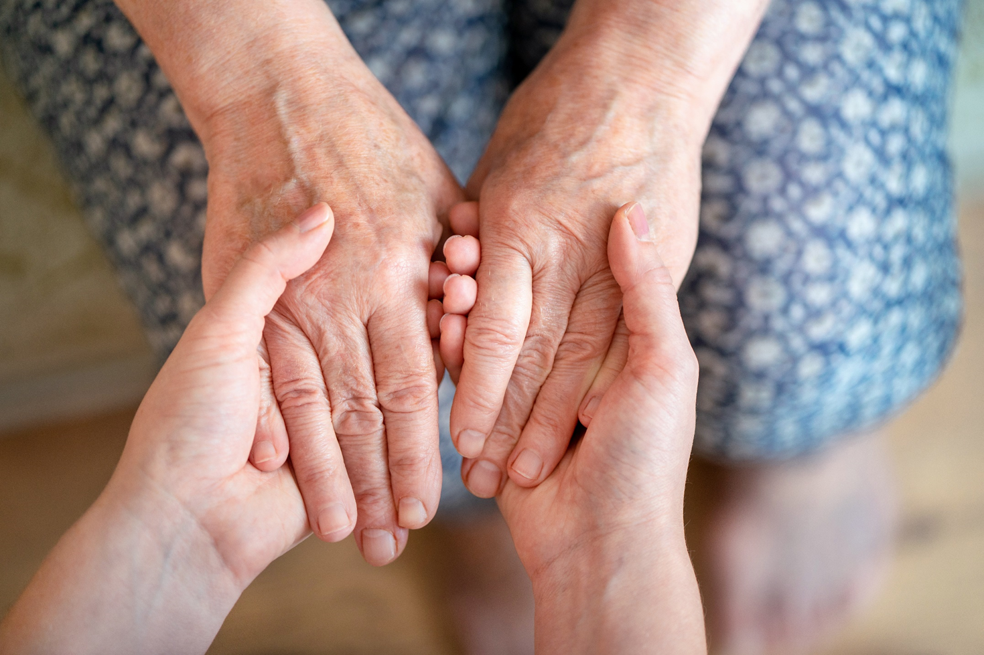
Assistance and support activities aimed at older people who are victims of crime
Prepared by Association For Integration and Social Development „Bunch”
Poland, Legnica (Lower Silesia)

Slide 2
The Association was created in 2016 by individuals who, in their field of work, often encounter other people’s needs, their difficulties and barriers which don’t allow them to function with dignity and peace.
The Association is a response to various social problems. Both individual and group-based, or local.
Our staff is made up of dynamic and well-educated people, who constantly deepen their knowledge. Among members of „Bunch” there are many specialists who want to go further in their careers and open themselves to the local community with passion.
They are psychologists, psychotherapists, lawyers, doctors, economists, journalists, speech therapists etc. Thanks to this team, we can tackle any problem and interdisciplinary subject. We hold these words close to our hearts: tolerance, respect, responsibility, awareness.
Grono (Polish language) a group of people connected by some distinguishing feature, e.g. common interests, friendship, etc.
Bunch (English language) a number of things, typically of the same kind, growing or fastened together.
"a bunch of grapes"

Slide 3
MAIN ASSOCIATION PROJECTS:
STOP HATE IN SCHOOL (2016-present) – Psychology workshops for students of elementary schools and above, along with free consultations for teachers and parents.
THERAPEUTIC CAMP FOR CHILDREN AND YOUTHS (2019) – The weeklong trip included many activities, that enabled the participants to rest and gain confidence in their abilities. Daily psychotherapeutic sessions, excursions, workshops, competitions, activities out in the field and at the location caused the children much joy and allowed them to charge their batteries for a new school year.
BETTER TOMORROW - Support Center (2018-present) – For people affected by crimes, their families and loved ones, and also crime witnesses. We offer free psychological, legal and psychotherapeutic help.
THE OFFICE FOR GOOD CAUSES - (opened in 2019) – Our Association has opened a volunteer club, with elements of sociotherapy for children and youths.
„FROM NOW”- SUPPORT CENTER (2020-2022) for former prisoners, their families and loved ones. We offer free psychological, legal and psychotherapeutic help. Also significant in-kind support.
„ SUPPORT FOR DISABLED PEOPLE” (2020-present) – We offer online psychological support for disabled people during the pandemic.
The goal of our Association for Integration and Social Development is, first of all, the development of free social services, and support for people and groups in danger of being excluded, while aiding the development of the region, and supporting its residents’ initiatives. We want our activism to come from a grassroots initiative and we want it to integrate with our society around shared goals.

Slide 4
SNAPSHOT ABOUT THE MAIN LIFE PROBLEMS FACING THE ELDERLY
The majority of seniors struggle with:
Their developmental space is shrinking: there are fewer social, physical and psychological spaces. They start to lose their independence. They start to become dependent on the help of others.
2. Unfavorable stereotypes of the elderly.

Slide 5
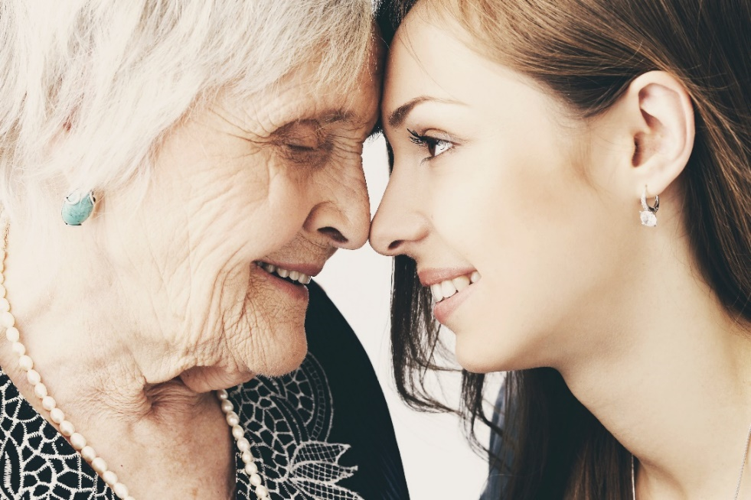
3. Rapid technological progress is challenging for the elderly, and many have fallen behind on learning to use technology.
4. Particular attention should be paid to elders during a pandemic.
5. The risk of being a victim of crime increases in proportion to age.

Slide 6
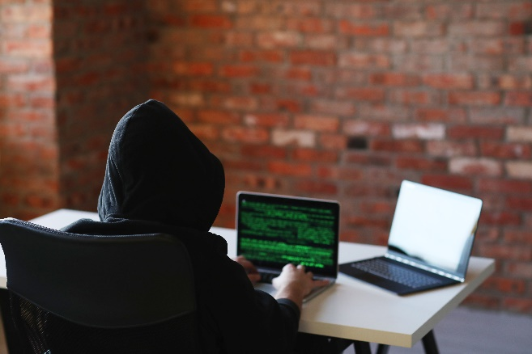
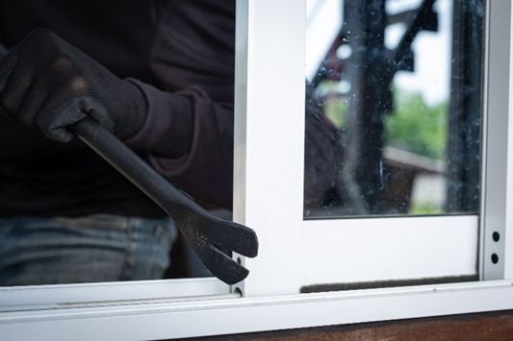
Violence against the elderly in Poland
- In 2020 more than 5,000 elderly were victims of fraud called „for Legend” , „for grandson”, „for police officers”.
-The elderly usually are the victims of fraud, robberies, and house break-ins.
-80% of victims in this group are over 70 years old.
Almost 6% of seniors over 65 experience domestic violence
The risk of being a victim of domestic violence in the age of 75-84 years old is more than 37%
1/3 of the victims deny that they are victims of domestic violence
The most common perpetrators are their guardians/caregivers (47%)

Slide 7
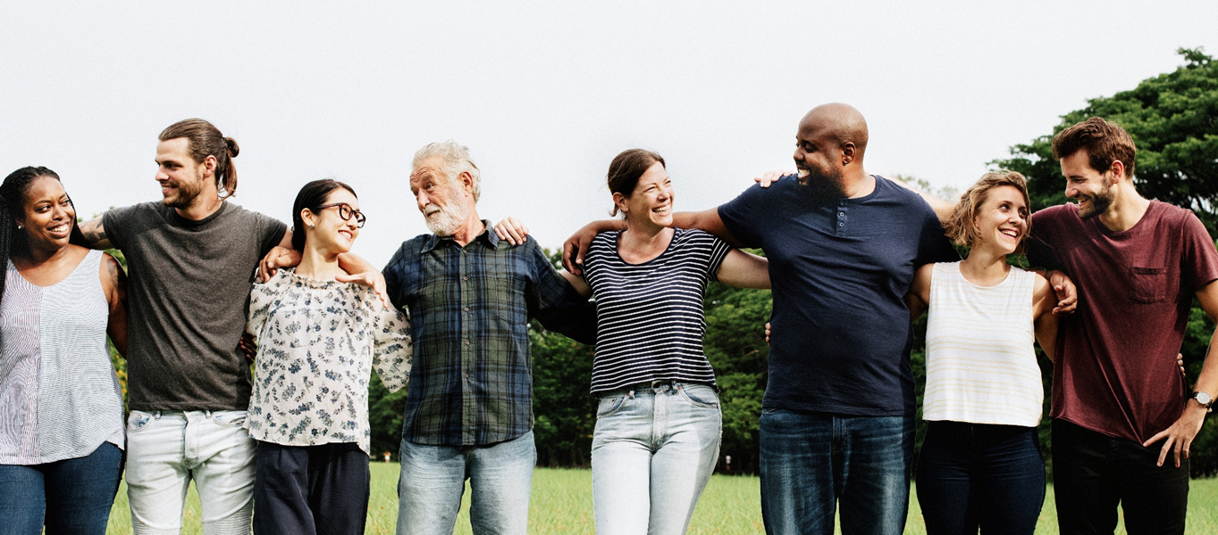
Effective help from others is key in helping prevent the elderly from becoming victims of crime

Slide 8
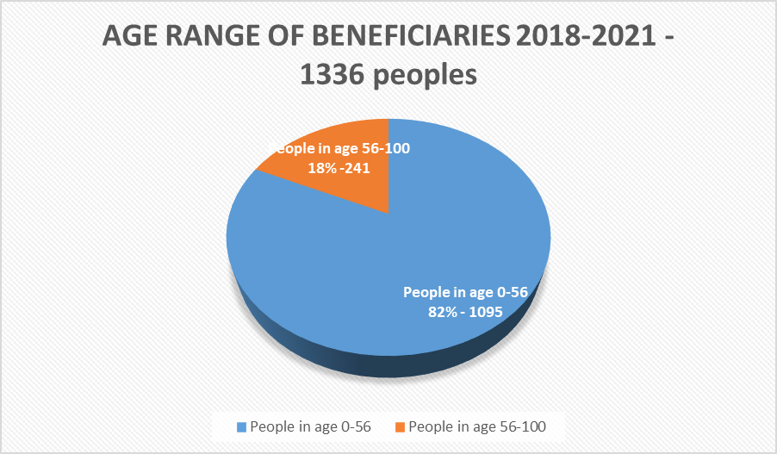
HOW DO WE HELP IN „BUNCH” ?
1. „BETTER TOMORROW”- Support Center (2018-present) – For people affected by crime, their families and loved ones, and also crime witnesses. We offer free psychological, legal and psychotherapeutic help, as well as material support.
In our bunch we trying to build the net of support through many social programs and projects.
The most important of them are:

Slide 9
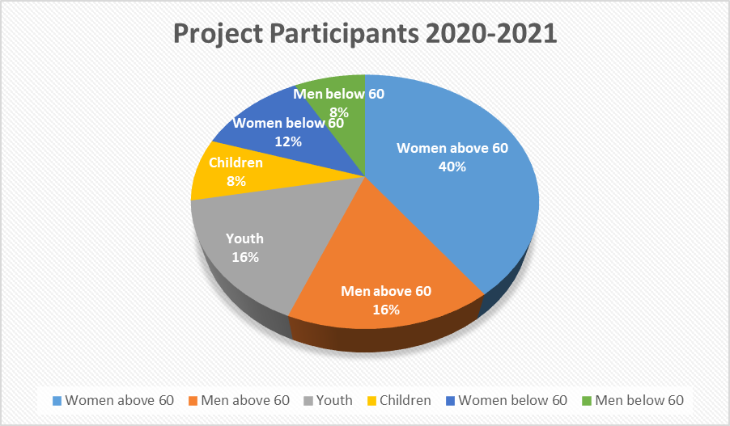
2. „SUPPORT FOR DISABLED PEOPLE” (2020-present) - We offer online psychological, psychiatric and legal support for disabled people during the pandemic, especially older people.

Slide 10
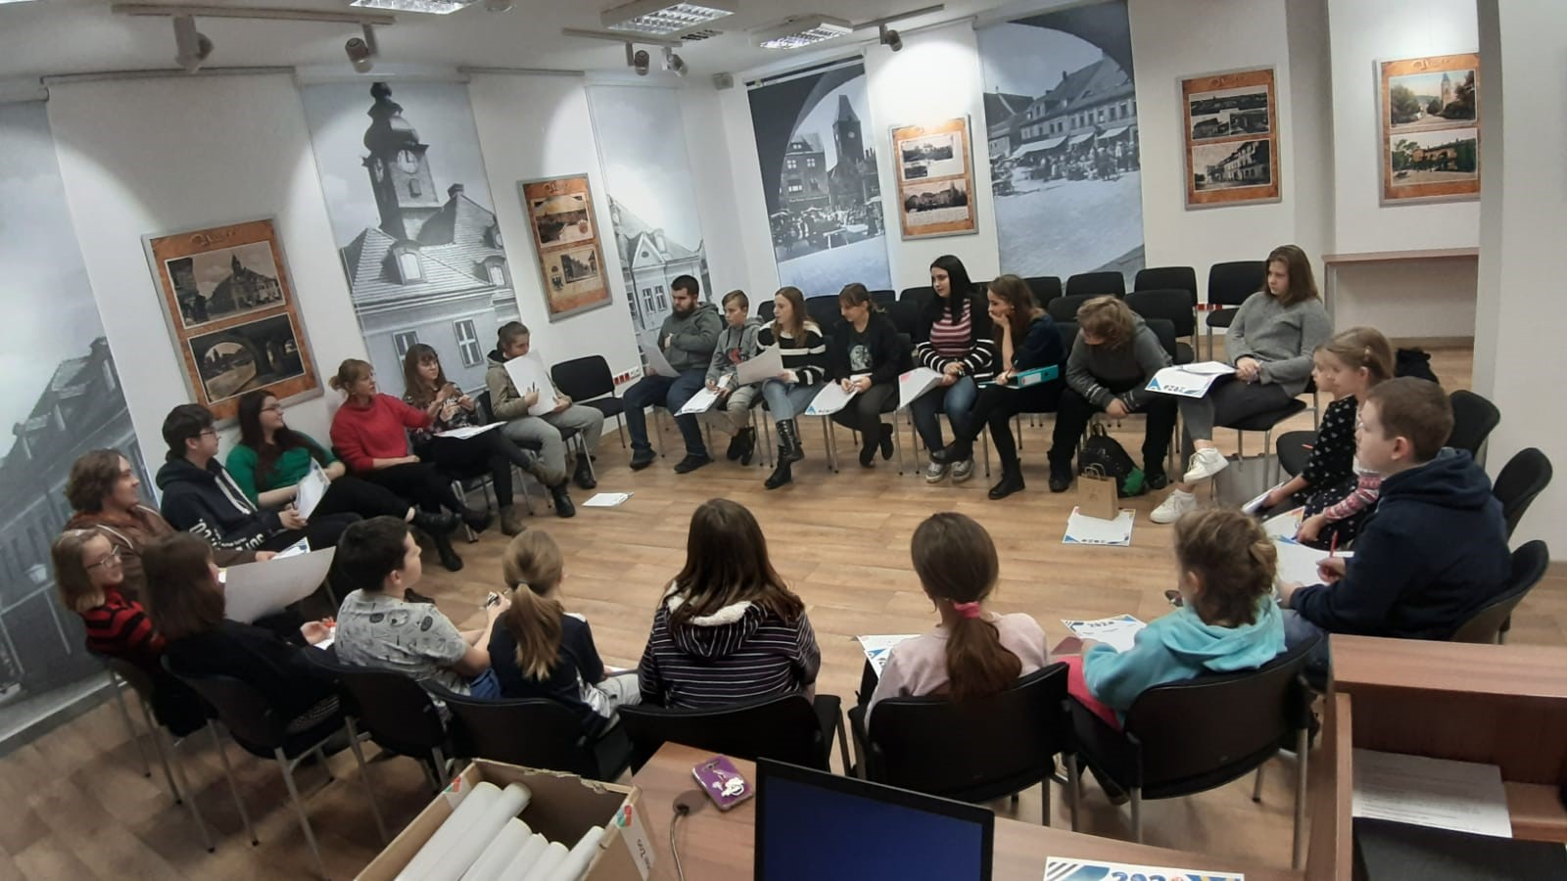
3. „THE OFFICE FOR GOOD CAUSES” - (opened in 2019) Our Association has opened a volunteer club, with elements of sociotherapy for children and youth.
We have 40 children and youth in our Office For Good Causes. They help many people a most of them are seniors. The pandemic has been a big test of their empathy.

Slide 11
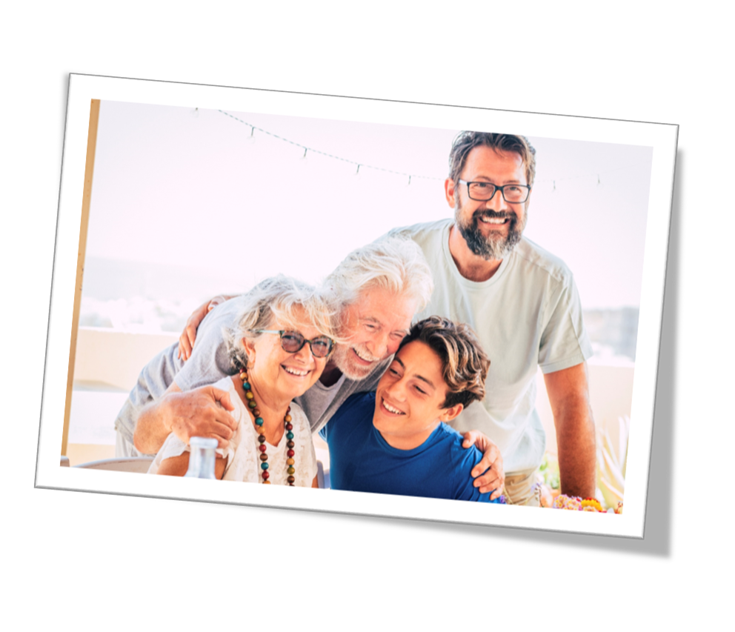
WE TEACH CHILDREN AND YOUTH THAT SENIORS ARE IMPORTANT!
They are an example for younger generations of how to deal with the next stages of life.
We must be aware that seniors have been shaped by a completely different world, so it is easy for them to talk about what is most important in life. That is what grandparents, great-grandparents, mentors, professors do because they think in terms of meaning they have a different frame of reference.
Being in contact with the elderly supports children’s acquisition of basic skills. Toddlers learn to recognize clearly what is good and what is bad. Regular contact with fulfilled grandparents is important for children in terms of development.
A decent place for seniors in society and in their families contributes to the feeling of solidarity between people, thus maintaining bonds. They are witnesses to history.

Slide 12
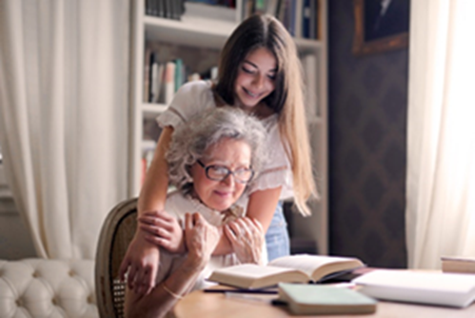
PROTECTING SENIORS - WE RELY ON THE ASSUMPTIONS THAT WE MUST REMEMBER ABOUT THEIR NEEDS. THIS IS THE BASIC ROUTINE OF ANY PROJECT
SENIOR NEEDS:
1. The need to perform socially useful activities.
2. The need to use free time in a satisfactory way.
3. The need to be recognized as part of society and to play a role in it.
4. Need for communication. Expressing their feelings and thoughts, listening and speaking is the basis of the feeling of coexistence in society. This translates into well-being and also physical health.
5. Need to maintain normal social contacts.
6. Need self-expression, including expressing their feelings.
7. The need to protect health and social welfare, maintain contacts with family members, and a sense of being cared for.
8. The need for closeness, tenderness.
9. The need for adequate mental and psychological stimulation.
10. Need for spiritual satisfaction.

Slide 13
COLLABORATION WITH OTHER NATIONAL INSTITUTIONS AND LOCAL ORGANIZATIONS IS VERY IMPORTANT IN CREATING A SUPPORT KIT AND IN PROTECTING SENIORS FROM BECOMING VICTIMS OF CRIME
For example:
Police:
Workshops with police officers on the safety of scared people. Teaching them about new types of crime to which they may exposed.
Mental Health Centers:
Creating support groups for people affected by crime.
Other NGOs:
Teaching new things related to technology.
Promoting a healthy lifestyle and openness.
Collaboration in the "Safe Senior" project.
Schools:
Promoting the good image of the elderly by involving young people.
Volunteering for the elderly.
Families:
Supporting those caring for their elderly family members in understanding their needs and planning for optimal support.

Slide 14
„Bunch” - Association For Integration and Social Development
Correspondence address:
ul. Ptasia 161
59-300 Lubin
Poland
https://stowarzyszeniegrono.pl/
THANK YOU FOR YOUR TIME

